Slide 1

Groupomania Internal social network By OLABANJO OMOTOSHO
Bybbbbh
An internal communication platform is a convenient platform for leadership of Groupomania to interact directly with the employees and vice versa.
The best employee engagement platforms are known for their ability to create positive employee engagement and boost their overall performance and loyalty to the Groupomania and made communication more fluid.
The underlying idea of an employee interaction social media is to create two-way communication between employees at all levels. The platform can convey information to the employees and collect feedback from them in return.

Slide 2
Agenda
PHASE 1
1. A presentation for Stephanie
The product vision.
The target.
The Impact Mapping
The reasons for choosing an agile methodology.
The project team and each member’s role.
The decision-making process using
Her role (Stephanie) in the organization as a sponsor.
The Recurring project events according to the agile methodology.
The tools and media used for this project management.
A user flow diagram of the user path.
PHASE 2
2. Product Backlog
3. The Sprint board
4. Schedule for a Sprint feedback meeting
5. Satisfaction criteria
6. Burndown chart
7. Sprint feedback report

Slide 3
Product vision
VISION: To improve Groupomania employee's motivation and engagement to increase productivity within the organization.
TARGET GROUP Users : Groupomania employees Customers : The human resource department and management of Groupomania | NEEDS To increase and sustain staff's satisfaction within work environment To improve employee's wellbeing To improve clear regular communication between departments To ensure even distribution of workload amongst Groupomania employees is enhanced | PRODUCT To create a new internal social network platform for Groupomania employees so as to build social interaction to improve their wellbeing Product features Account creation must be simple and possible from a mobile phone Users profile must include little information for quick completion Account deletion must be possible Multimedia publication must be possible Written content must be possible Unread post must be easily identify by users | BUSINESS GOALS To improve employee's productivity within Groupomania so as to increase profit by 35% in 24 months To make Groupomania the best place to work in 5 years To make on-boarding of new employees flawless and satisfying and also improved by 45% To increase clear communication between departments by 75% in 2years to achieve bonding amongst staffs for smooth running of Groupomania To enable even distribution of workload amongst colleague so as to increase employee's productivity by 45%

Slide 4

Persona
NAME & PICTURE | DETAILS Joe Black is male of 31 years of age. He is a complaint officer at Groupomania. Earns £45k per annum. He likes socializing with colleagues at work and friends outside the workspace which makes him a frequent user of social platforms. He is a problem solver within any space he found himself making him friendly with people around him. | GOAL The social interaction platform would be a suitable media to enhancing the already established friendly attitude and character of Joe Black which would make him more accessible to colleagues to proffer solution to problem when they encounter bottle necks thereby improving interaction and wellbeing of staffs which would eventually translate into increased productivity for the organization.
Name : Joe Black

Slide 5
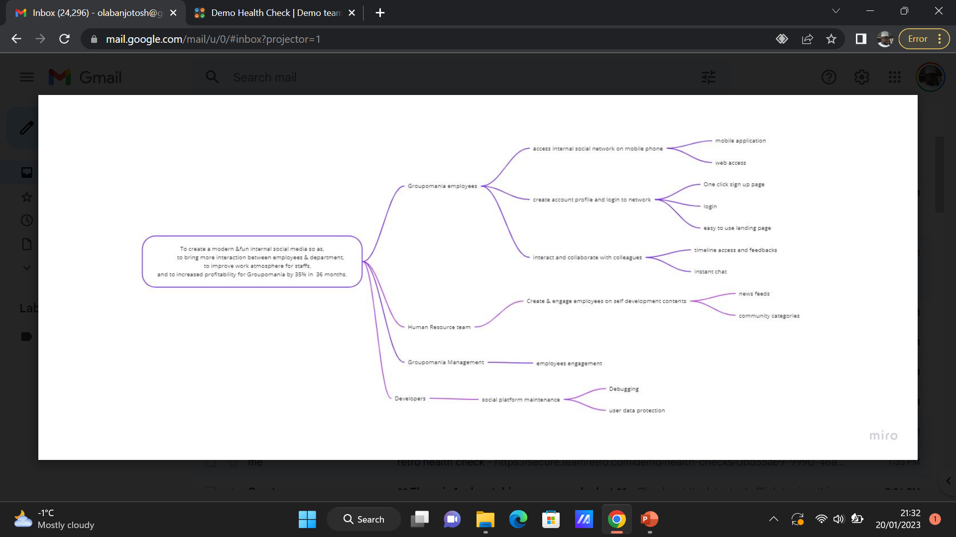
Impact mapping

Slide 6
Reason for choosing Agile
AGILE | WATERFALL
Flexible to change and welcomes adapting to different directions. | Strict to change
Stakeholders are involved to give feedbacks to the dev. team as they make progress during diff. phases of the project | Incorporating client feedbacks is not an ongoing part of the process
Budgets are more flexible as project progresses | Budget is fixed. No room for budget change
Early returns on investment by regular delivery | Risk of nothing to show for the money until the end
Team is multi-functional and works collaboratively
/

Slide 7
The project team and each member’s role
Project manager
I as the Project manager, I am accountable for organizing ,tracking & leading team to execute tasks and activities within this project.
Scrum master
Laura is accountable for establishing Scrum on the internal social interaction project by helping everyone both within the team and Groupomania understands scrum practice and theory.
She helps remove obstacles & distractions that may impede the team from meeting the product goals.
She helps team streamline processes by which they achieve their goals
She facilitate daily scrum meetings which is a 15mins meeting where we discuss tasks that was achieved yesterday, tasks to be achieved today and also if there are any blockers.

Slide 8
Designer
Anne is responsible for problem solving & planning the internal social interaction platform.
She develops design specifications in accordance with Groupomania business requirements.
She designs, develops & execute unit test plans, test designs, test cases & test strategies & also document all test plans, test cases & strategies procedure issues.
Full stack developer
Dominique is a computer programmer responsible for encoding the front & back end and also designing the internal social platform user interaction interface.
He also develops the site functionality.
Data engineer
Rodrigue is responsible for analyzing & organizing raw data for user list.
Tester
Vlad is responsible for user account testing to detect non authenticated user to access internal resources and to test site for dimensional responsiveness to know how the internal social interaction platform will load quickly without distortions.

Slide 9
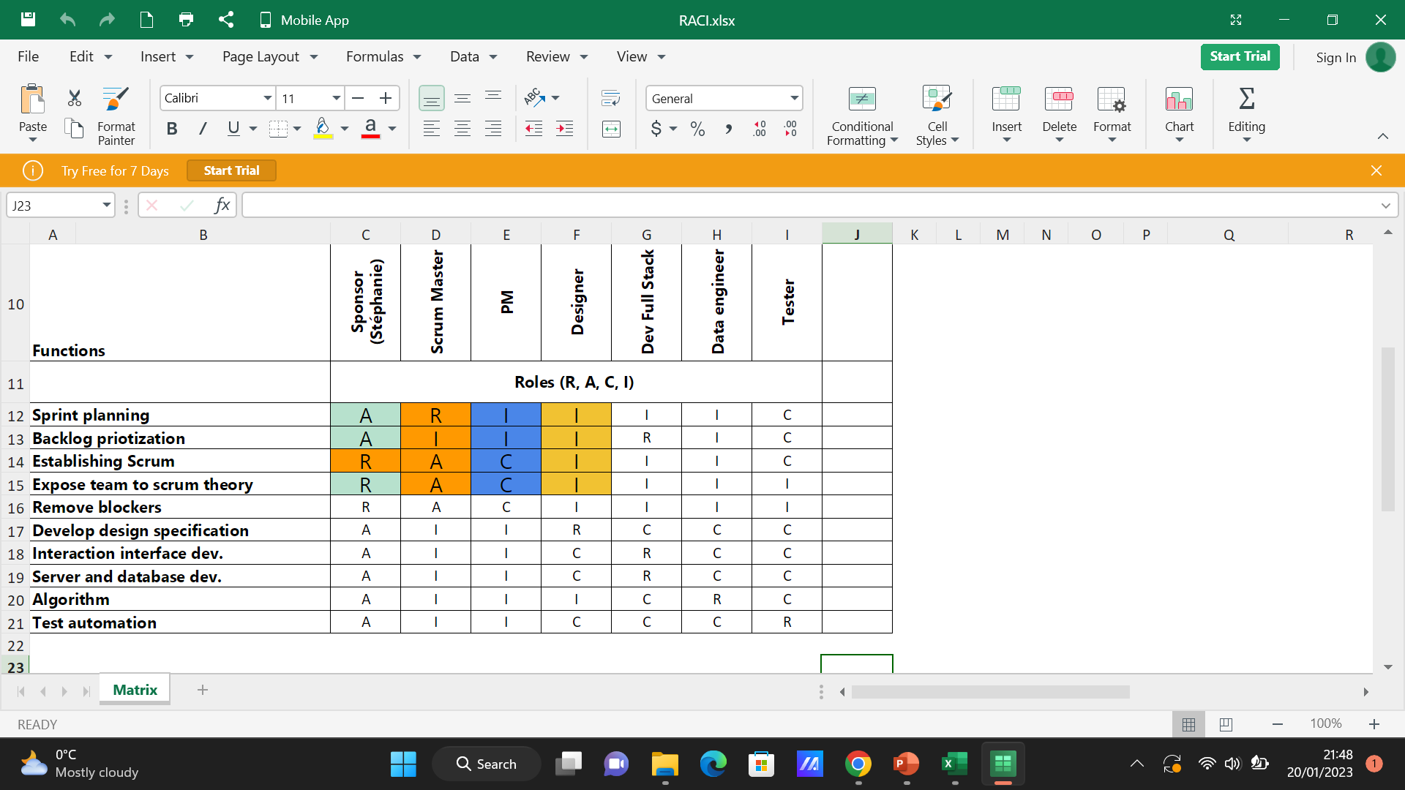
Decision making. RACI

Slide 10
Stephanie’s role as sponsor
Stephanie attends the sprint review meeting as the project sponsor
Stephanie is accountable for the internal social media project success
She provides guidance & resources to the project team
Stephanie is accountable in aligning the internal social media project needs with Groupomania’s business goal to bring about a significantly positive impact on the overall performance of staffs, create positive employee engagement and boost their overall business performance and loyalty to the organization
Stephanie ensures proper launch & execution of the internal interaction platform
She manages risks & changes while ensuring and maintaining project quality

Slide 11
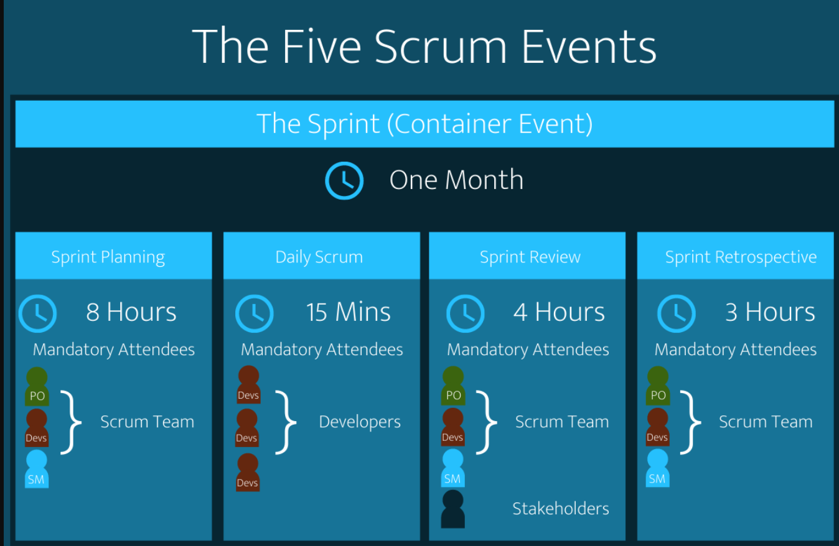

Slide 12
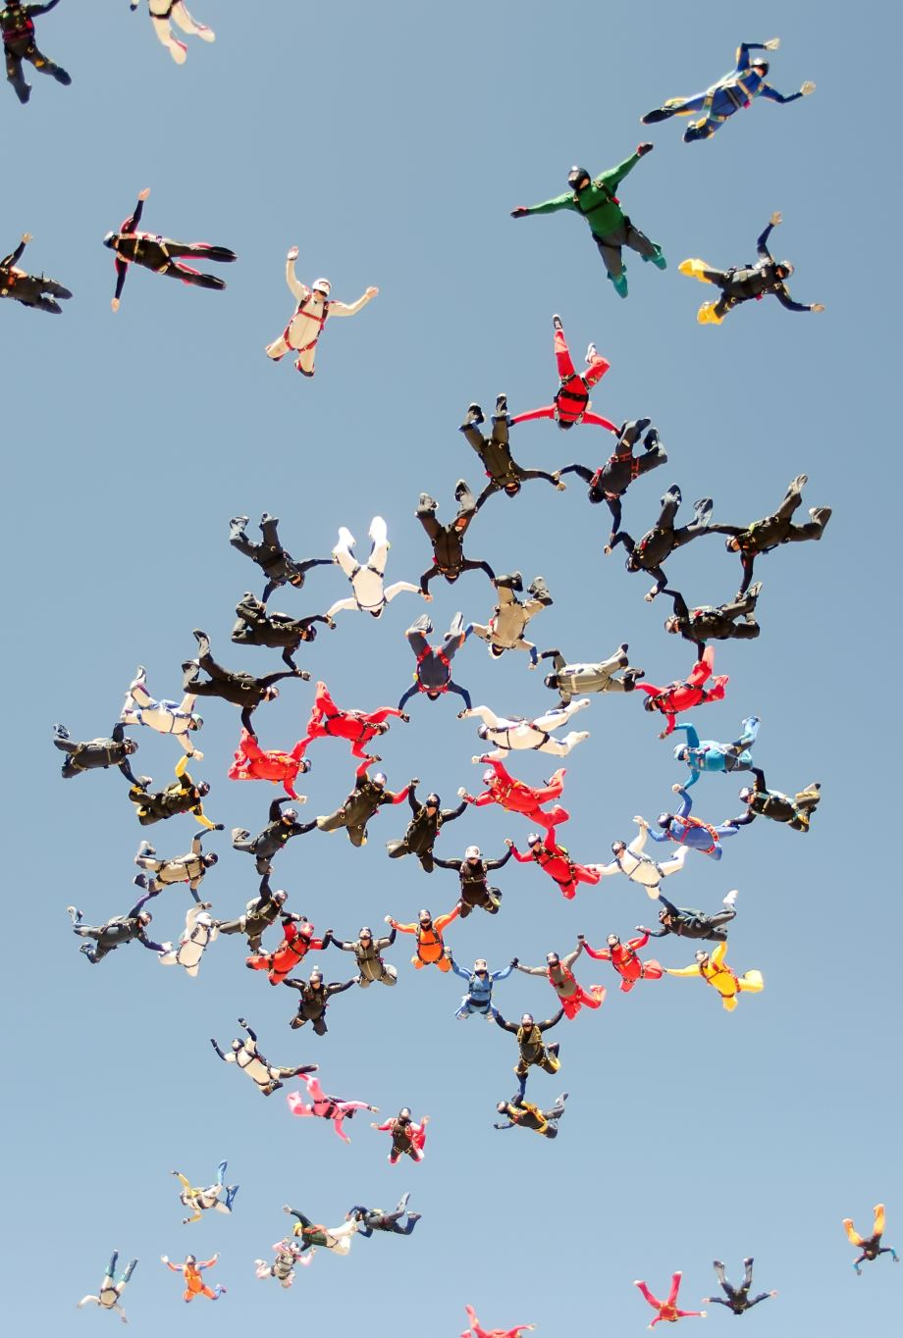
Sprint
Shippable products are realized incrementally after each iteration and a new sprint commences immediately after concluding previous sprint.
Sprint planning
The sprint planning session is the gateway to the sprint event. Tasks to be worked on are laid out collaboratively amongst the project team which is facilitated by Stephanie, the product owner.
Daily scrum
It is a 15mins daily event that takes place during the current sprint to discuss previous day tasks achieved, tickets to be worked on today and to discuss any blockers to inspect progress towards the sprint goal.
Sprint review
This is to inspect outcome of the sprint and discuss future adaptation. The team present the outcome of the sprint to key stakeholder and progress towards achieving the product goal.
Sprint retrospective
The purpose is to plan for effectiveness and quality. The team inspects how the sprint went with regards to collaboration, tools used, processes and definition of done. They discuss what went well, what didn’t go well during the sprint and ways to improve in the next sprint.

Slide 13
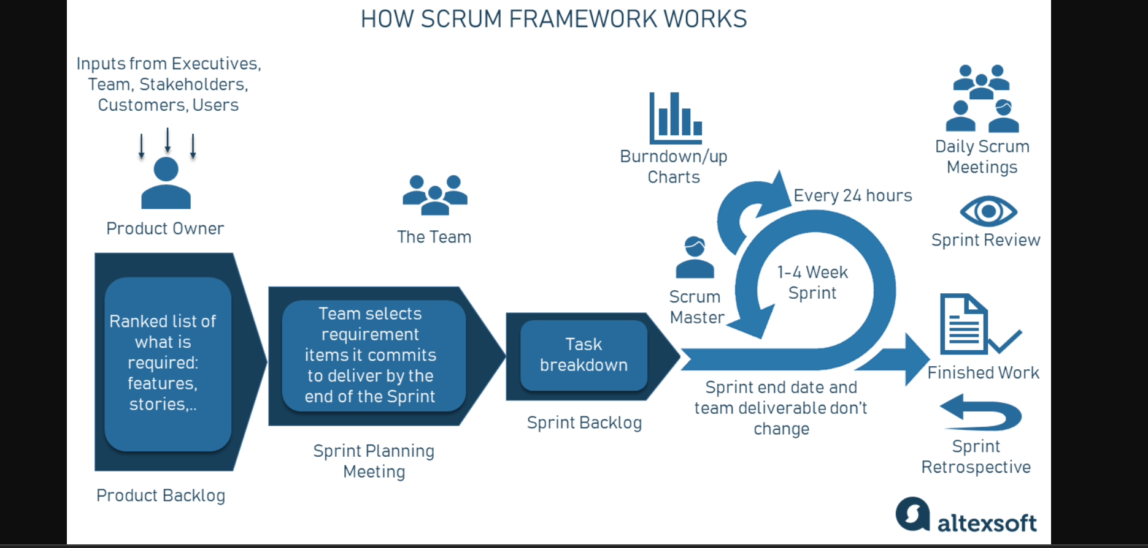

Slide 14
Tools &media used for this project management
Power point
Miro
Whimsical
Trello
Excel spreadsheet
Ideazboard,,Roman pitcher vision board

Slide 15
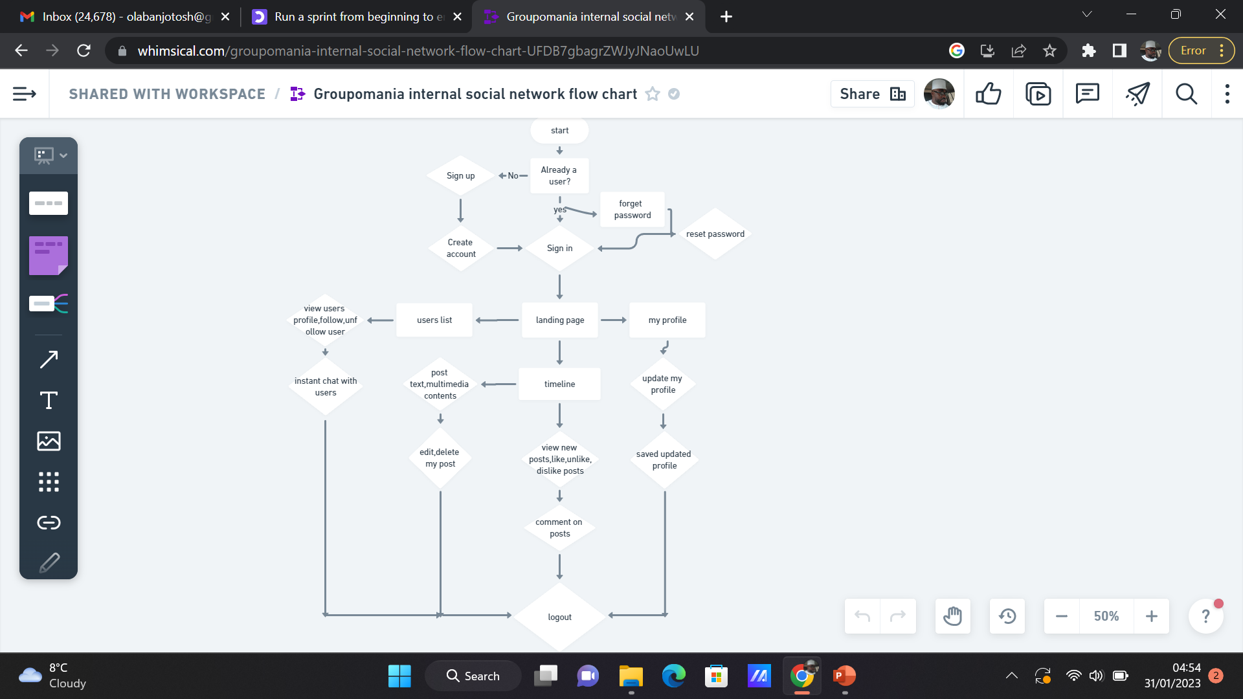
User’s Journey

Slide 16
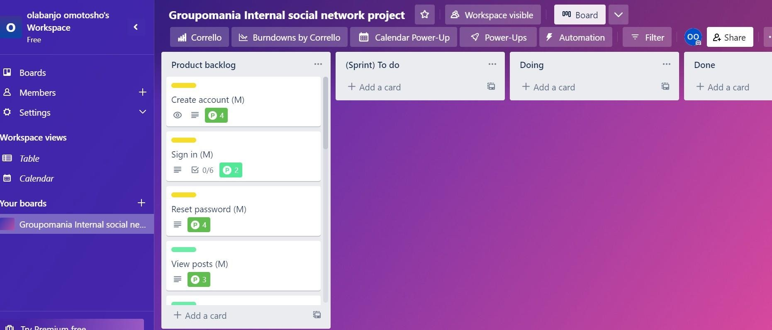
Product backlog https://trello.com/b/oZnd8E0Y/groupomania-internal-social-network-project

Slide 17
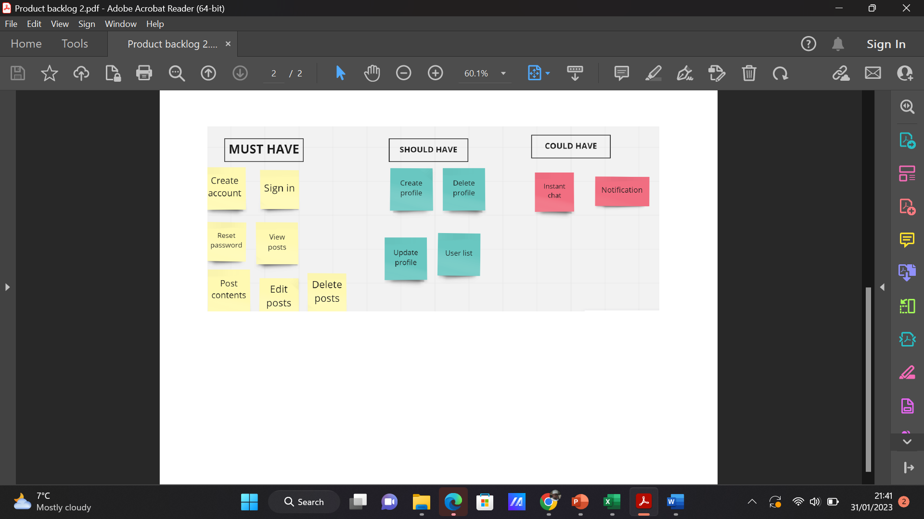

Slide 18
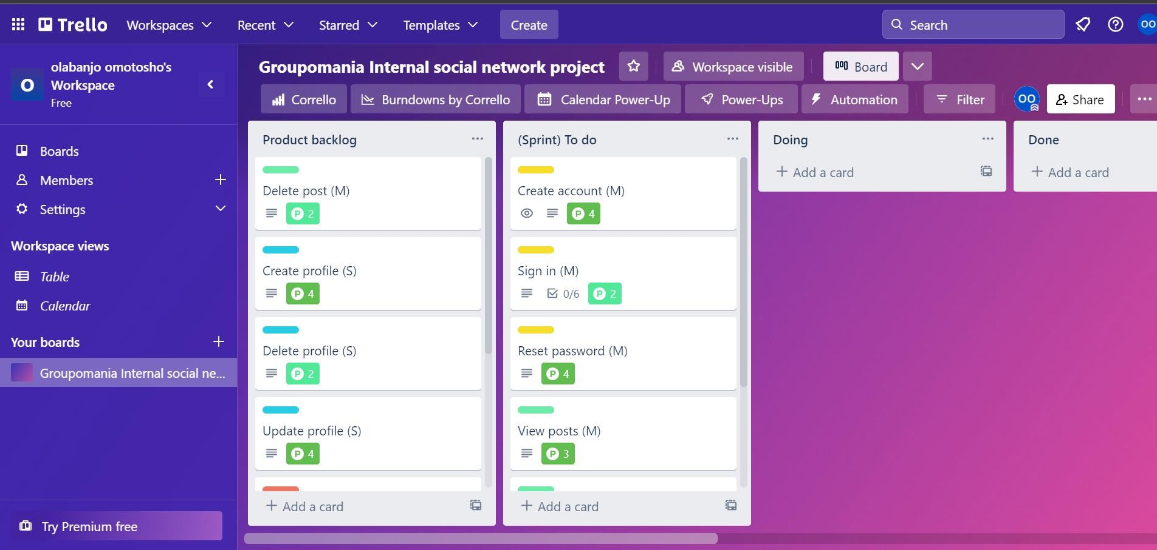
Sprint board

Slide 19
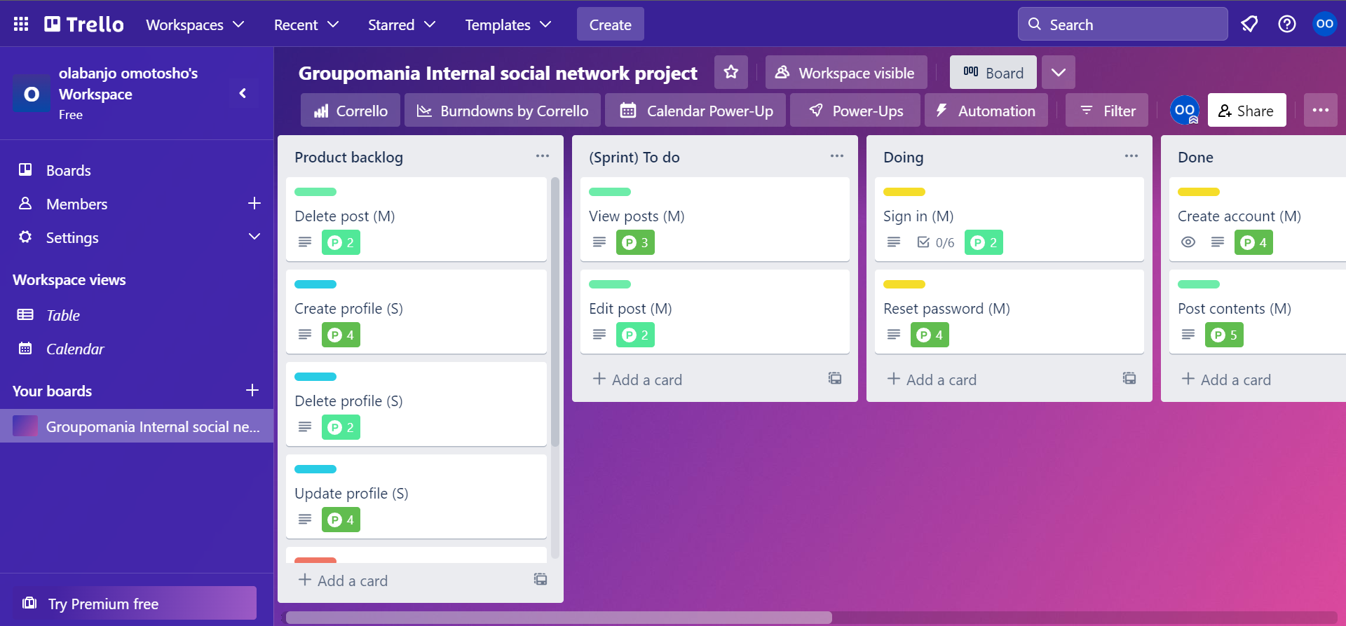

Slide 20
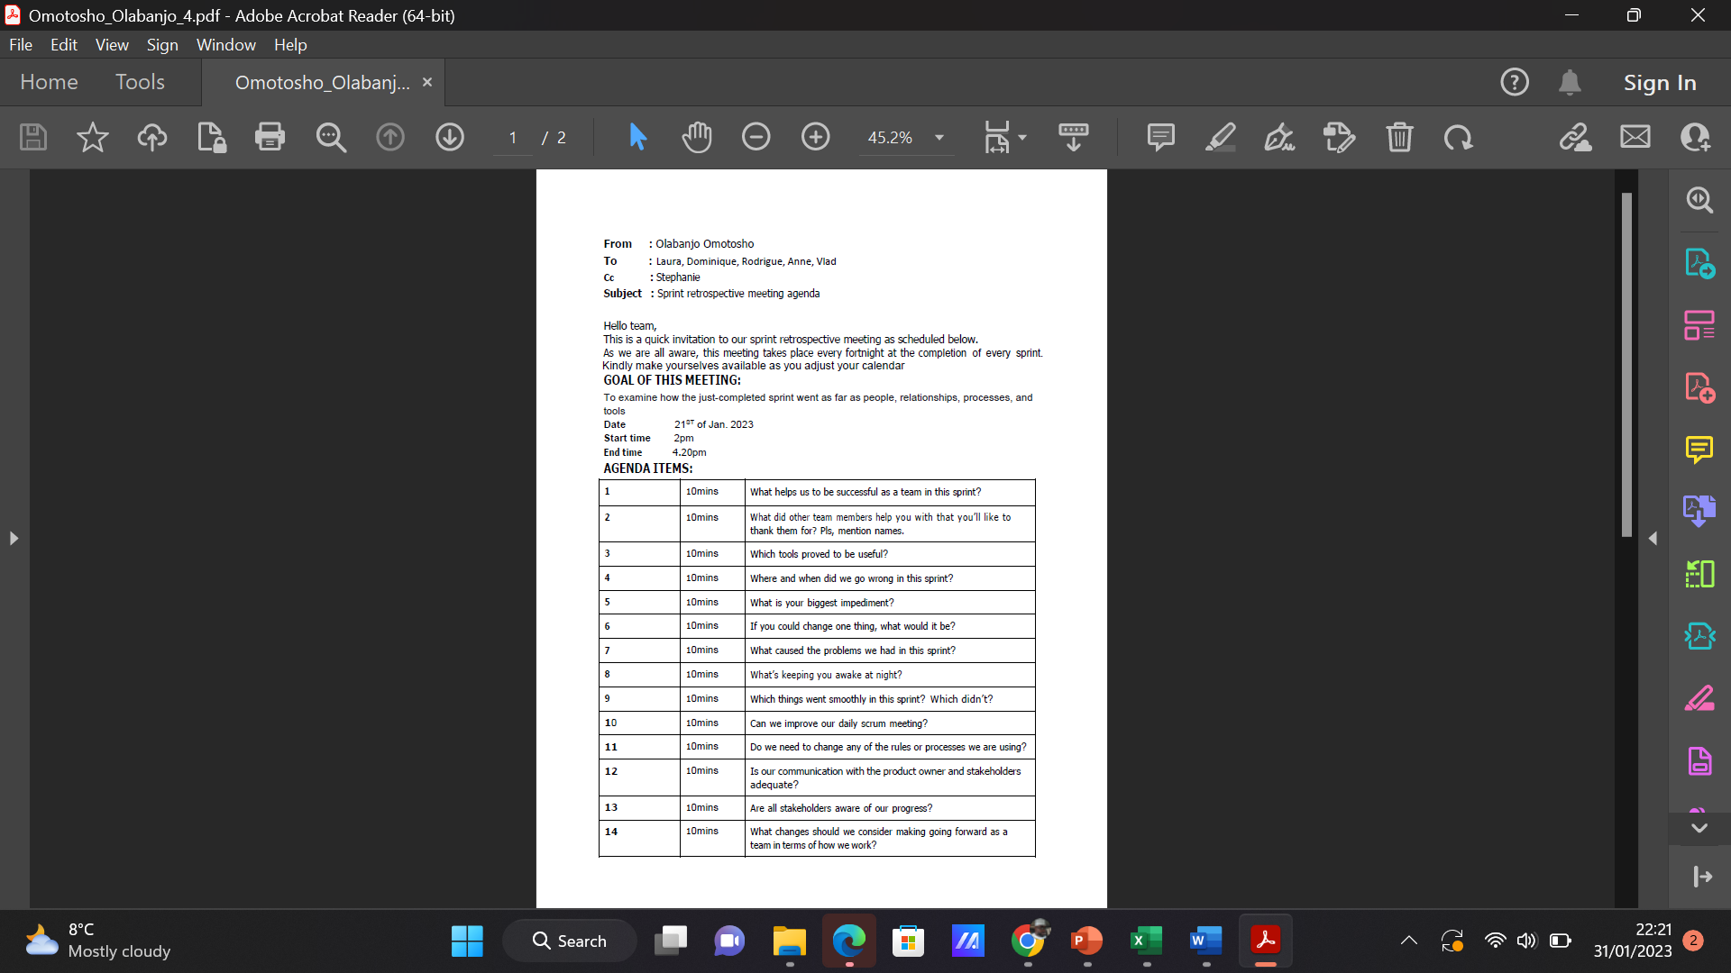
Sprint retrospective meeting agenda

Slide 21
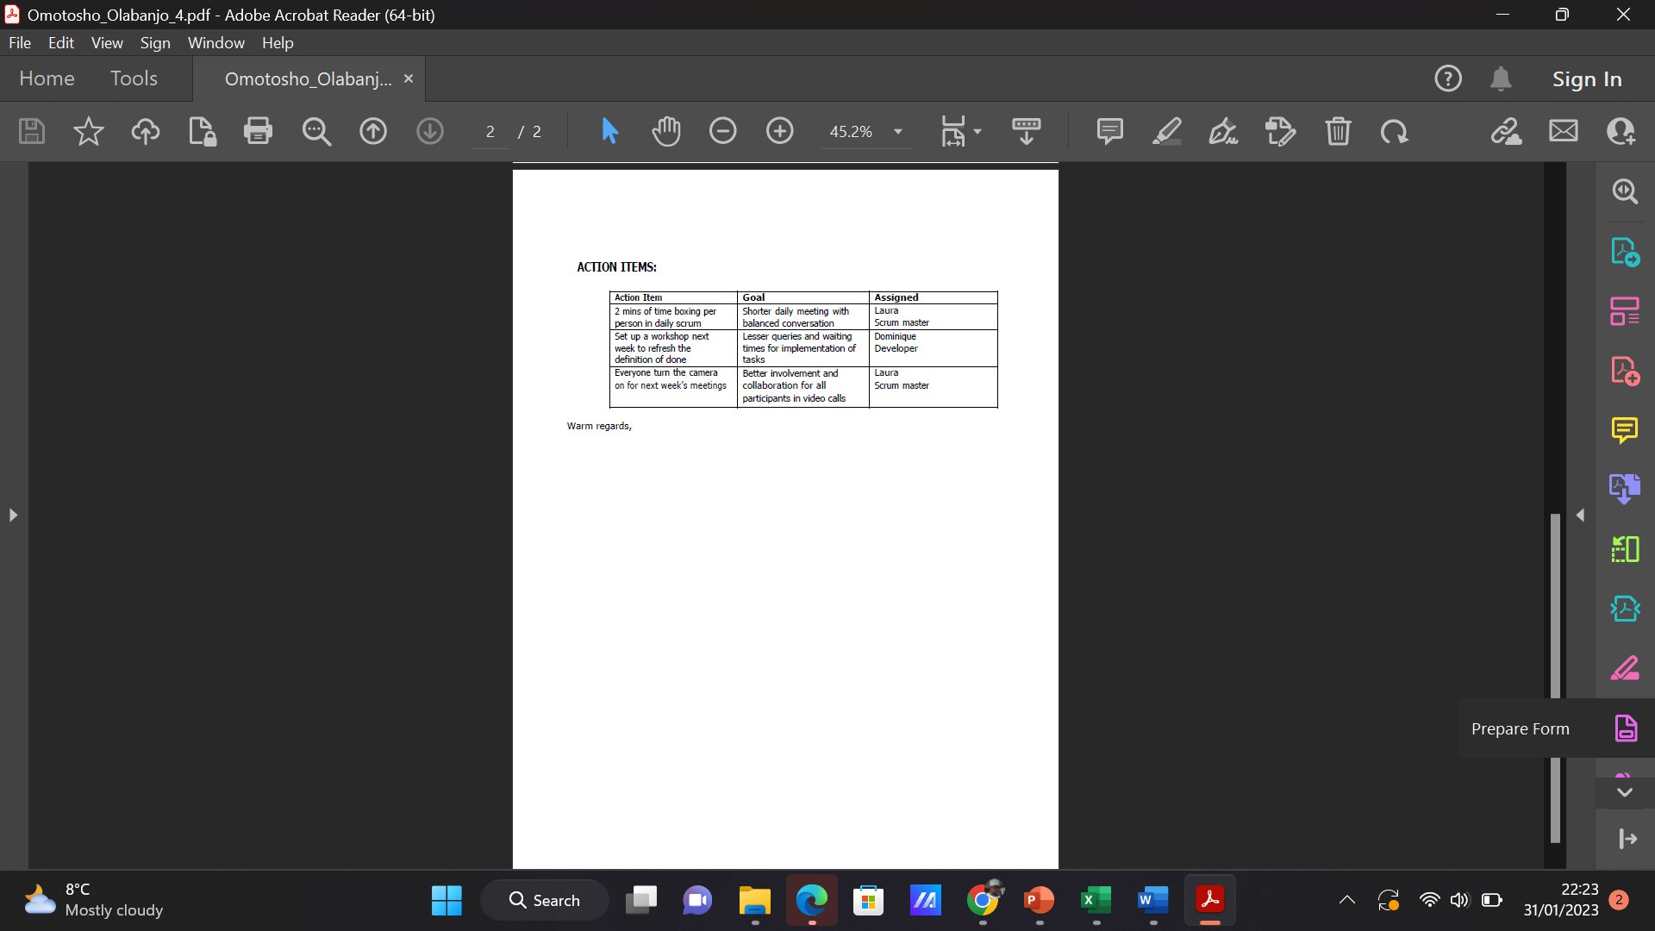

Slide 22
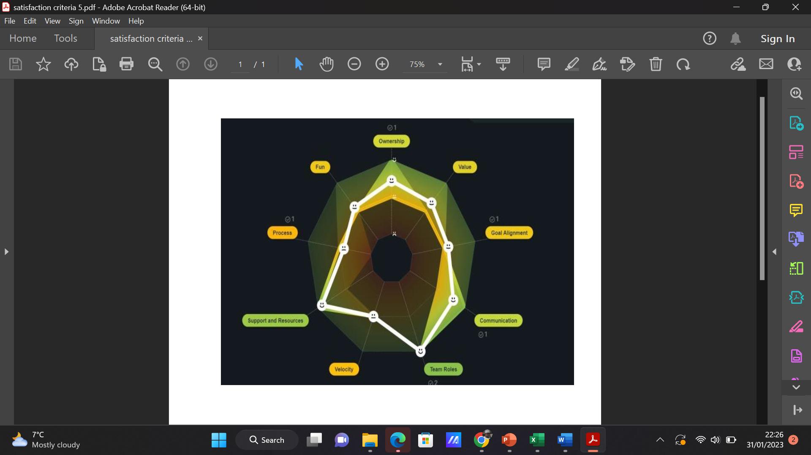
Satisfaction radar

Slide 23
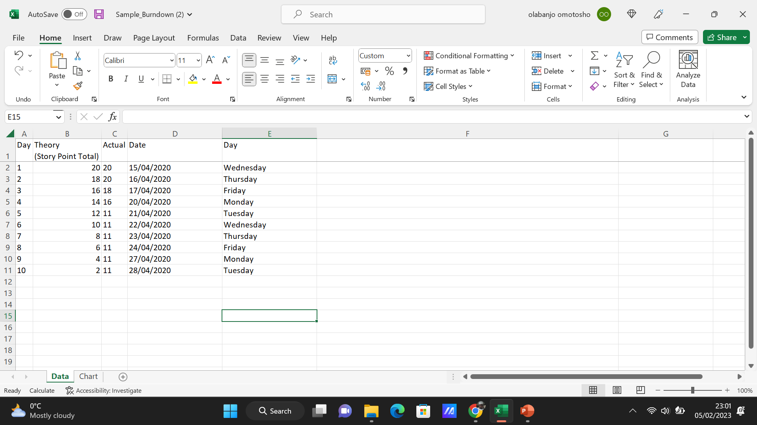
Burndown chart

Slide 24
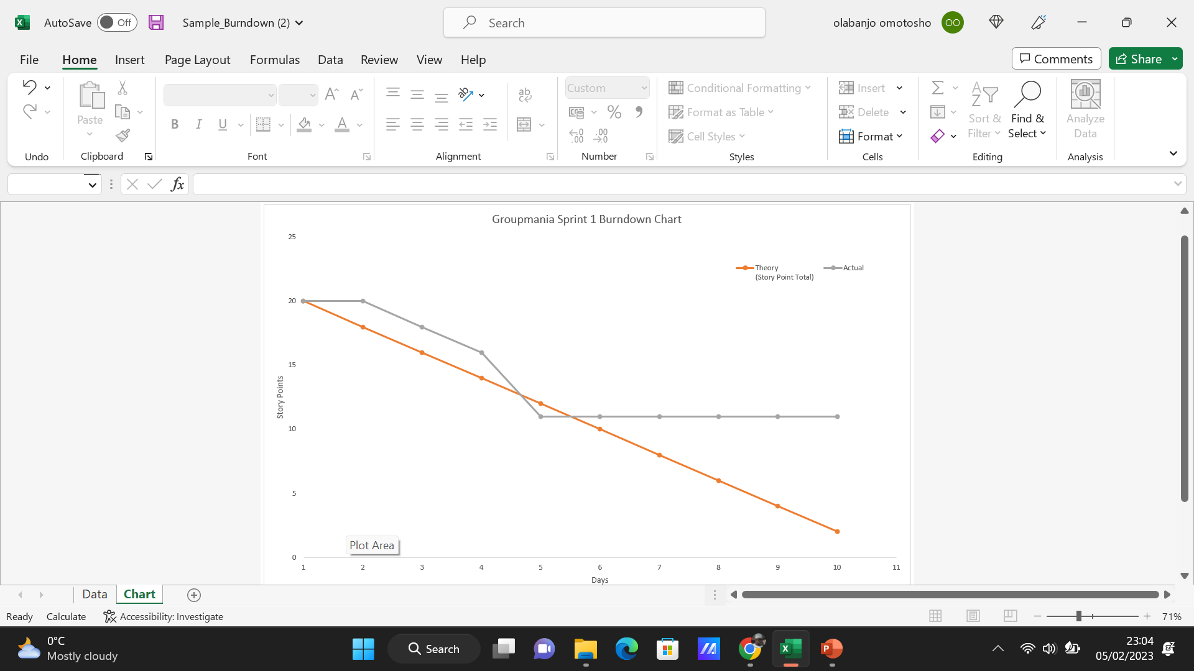

Slide 25
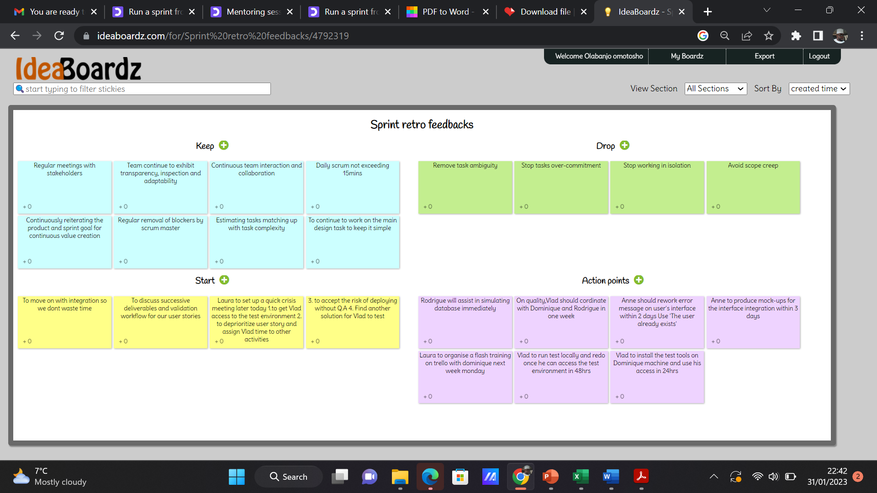
Sprint retro feedback report

Slide 26

Thank you

